Slide 1
Presentation to Medicines Classification Committee May 1st 2012
Tim Roper
Executive Director
New Zealand Self Medication Industry Association

Slide 2
A New Approach to Benefit-Risk Assessment for Nonprescription Drugs
Eric P. Brass, M.D., Ph.D.
Professor of Medicine, David Geffen School of Medicine at UCLA
Director, Harbor-UCLA Center for Clinical Pharmacology

Slide 3
The evolving nonprescription environment: Regulatory, political and public perceptions
Benefits of nonprescription status
poorly understood and under valued
Risks understood
and mitigated to degree
possible
Benefit
Benefits from improved access
to effective drugs
RISK
Risks well publicized,
dramatic, easily
understood
Benefit
RISK
Risks increasingly seen as outweighing benefits
Corollary: Something must be done, even if “what” isn’t clear
Action better than inaction

Slide 4
Thinking about benefit and risk for nonprescription drugs – NOT the same as prescription drugs
Regulatory decision is often not availability vs nonavailability but marketing status: prescription vs. nonprescription status for specific drug
Thus, incremental benefit and risk relevant comparing self-care vs. healthcare professional directed care
Incremental benefit and risk determined primarily by consumer (and pharmacist) behaviors
Comparison to use of prescription drugs in “real world” most relevant

Slide 5
Thinking about benefit and risk for nonprescription drugs – NOT the same as prescription drugs
May need to understand consumer behaviors in absence of nonprescription option – not simple self vs supervised care
Result is unique set of “benefits” and “risks”
Challenges to developing data to characterize these benefits and risks to support evidence-based decision making

Slide 6
Potential benefits of nonprescription drugs
BENEFIT DOMAINS
Convenience/improved access
Improved outcomes
Symptom relieve/quality of life
Significant impact on morbidity/mortality
Public health benefits
Increased consumer involvement in health
Economic
Utilization of other health care resources
Consumer time
Acknowledged by
many, but
quantitative,
effective examples
limited

Slide 7
Potential risks of nonprescription drugs
RISK DOMAINS
AE when used as directed – NOT relevant as same as prescription
AE with unintended misuse
AE with intentional misuse with therapeutic intent
AE with accidental ingestion
AE with intentional overdose
“Recreational” intent
Suicidal intent
Worsened outcome from delay in optimal treatment
For nonprescription drugs
absolute rate of adverse
events low, examples
with severe clinical
consequences rare,
but cases dramatic and thus
high impact
Nonprescription risk = Frequency of not following label
X clinical consequences of incorrect behavior

Slide 8
Can tools be developed to improve benefit-risk analysis for nonprescription drugs?
Expert collaboration formed to address question
Eric P. Brass, M.D., Ph.D. – UCLA, USA
Ragnar Lofstedt, Ph.D. – Kings College, UK
Ortwin Renn, Ph.D. – University of Stuttgart, Germany
Operated under contract from World Self-Medication Industry (WSMI)
Charter specified that we had full editorial control over any publications, etc.

Slide 9
Goals of working group
After assessing issues, goals established as:
Develop tools that can:
Comprehensively identify benefit and risk characteristics for nonprescription drugs
Allow for early, transparent agreement among stakeholders around benefits and risks
Optimize benefit-risk assessment tools for application to nonprescription drugs while providing flexibility for regulators to adopt to unique needs
Illustrate the application of the proposed tools
Prepare scholarly publication presenting work

Slide 10
Desirable characteristics of a benefit-risk model for nonprescription drugs
Reviewed public comments by regulators and experts
Transparency
Basis for decision making understood by all stakeholders
Sophistication may hinder transparency
Allow evaluation of incremental benefits and risks
Maximize favorable individual and public health impacts
Accept heterogeneous inputs
Experience with model in other regulatory environments may increase acceptance
Flexibility to meet needs of individual regulatory environments/cultures

Slide 11
Approach of the working group
Step 1:
Develop a tool that allows the prospective, comprehensive and transparent identification of product-specific characteristics that contribute to both potential benefits and risks

Slide 12
Value tree framework
for nonprescription
drugs
XXXXXXX
Improved access
XXXXXXXX
Improved clinical outcomes
XXXXXXXX
Improved public health
Benefit
Considerations
XXXXXXXXX
Enhanced consumer involvement
Economic benefits
XXXXXXXXX
Benefit-Risk
Considerations
YYYYYY
Unintended misuse
YYYYYY
Intentional misuse with
therapeutic intent
Risk
Considerations
Accidental ingestion
YYYYYY
Intentional overdose
YYYYYY
Brass et al Clin Pharmacol
Ther 90:791, 2011
Worsened outcome due
to self-management
YYYYYY
Common Domains for
Nonprescription Drugs
Product-Specific
Characteristics

Slide 13
Example of value tree use:
nonprescription nicotine
replacement therapies
(NRTs)
Improved access
Increased cessation attempts
Improved clinical outcomes
Increased number of consumers
successfully stopping smoking
Improved public health
Decreased smoking rates
Benefit
Considerations
Enhanced consumer involvement
Increased adoption of
healthy lifestyles
Economic benefits
Benefit-Risk
Considerations
Unintended misuse
Increased adverse events due
to exceeding dose/duration
Intentional misuse with
therapeutic intent
Combined use with smoking
Risk
Considerations
Accidental ingestion
Use during pregnancy
Intentional overdose
Abuse, abuse by adolescents
Brass et al Clin Pharmacol
Ther 90:791, 2011
Worsened outcome due
to self-management
Decreased success rates vs.
healthcare provider supervised
Common Domains for
Nonprescription Drugs
NRT-Specific
Characteristics

Slide 14
Potential advantages of the value-tree framework
Can be applied early in development and facilitates discussions with regulators
Allows those characteristics which are major drivers of benefit and risk to be prioritized
Facilitates efforts by industry to generate data to support decision making around each characteristic
Conceptual framework: Importance = clinical consequences X frequency of occurrence
Provides input into Step 2 – Application of a specific risk-benefit analysis tool

Slide 15
Approach of the working group
Step 2: Integrate value-tree tool to decision making tools and comprehensive benefit-risk framework
Great flexibility inherent in value-tree tool
Readily provides input for decision making tools, including multiple criteria analysis (MCA)
Advantages of MCA:
Accepts varied inputs, including expert consensus, qualitative evaluation
Allows weighting of characteristics based on clinical importance
Flexibility in grading systems to allow use with varied products and regulator preferences

Slide 16
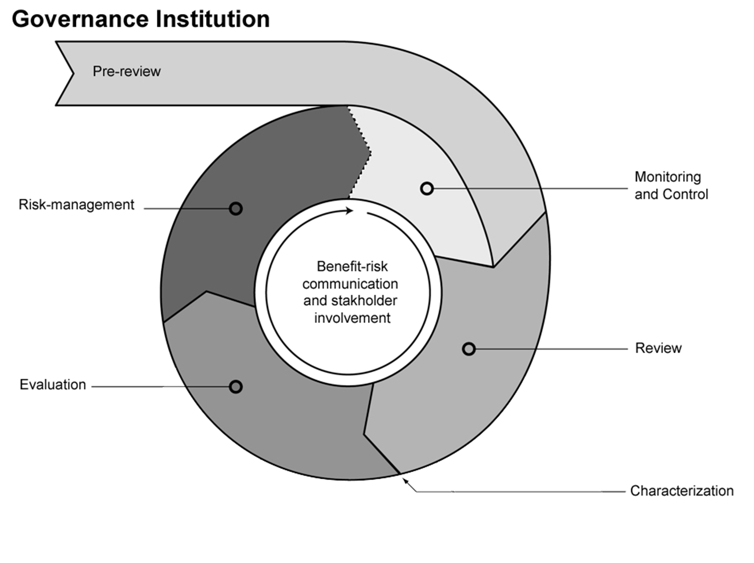
Suggest using tools in comprehensive framework
International Risk Governance Council (IRGC) Framework: maximize communication and transparency
Brass et al Clin Pharmacol Ther 90:791, 2011

Slide 17
Summary
Proposed tools:
Allow comprehensive identification of relevant benefit and risk attributes for specific nonprescription drug candidates
Facilitates early agreement between sponsors and regulators on most important characteristics, important data gaps and approach to integrated benefit-risk assessment
Flexibly supports varied benefit-risk assessment methods, particularly multiple criteria analysis
Integrated into Framework that emphasizes transparency, communication and evidence-based decision making supplemented by balanced expert opinion
Publication to initiate dialog on the important issues

Slide 18
2012 - A Time of Opportunity
A proactive industry can provide regulators with the information and tools they need to make balanced, informed decisions
Help identify the right questions
Provide data to address the questions
Develop innovative research methods to ensure most informative data provided
Validate risk mitigation tools to increase regulator and public confidence
An effective benefit-risk assessment framework will guide all of the above
Regulators and manufacturers want a robust nonprescription sector
The public and policy makers need a robust nonprescription sector

Slide 19
Thus, benefit-risk assessment poses unique challenges for both regulators and manufacturers
New datasets required for defining incremental benefit and risk vs. prescription
Tools and examples for defining individual/public health benefits and risks for nonprescription drugs limited
Need for research innovation
Nontraditional datasets may be highly relevant
All need to acknowledge regulators need to ask questions they can’t answer
Manufacturers have critical role in addressing
Opportunity for setting the agenda and framing the questions

Slide 20
A new Approach to Benefit Risk assessment
Of non prescription medicines
AESGP Conference, Copenhagen, February 2012
How to Apply the New Approach
Sheila Kelly
Chief Executive, PAGB

Slide 21
WSMI task force
Associations
US
Canada
Companies
Pfizer
GSK
Reckitt Benckiser
Novartis
UK
AESGP
Latin America
Japan
New Zealand
Australia
Notes:
For the past two years I have been part of a task force has been working at global level with input from association staff from US, Canada, Australia, Europe and UK.
We have had support from Pfizer, GSK, Reckitt Benckiser and Novartis
The framework that Eric has just presented is the outcome of that work and I am pleased to have the opportunity to talk to you about it from an industry perspective.
Let me start by talking about why we need this

Slide 22
Sliding Scale of Risk and Benefit
Non Prescription Medicines
OTC medicines for long term or recurring illness or prevention
Medical Devices
Herbal medicines
Traditional use
OTC Medicines for Self-Care for short term illness
Prescription Medicines
Homeopathic Remedies
Quality only
Traditional
Plausible Evidence
Products containing ingredients with
Established Use
Clinical studies while POM plus real life data
Clinical
trials
RISK / BENEFIT
Notes:
OTC markets have broadened over the last 40 years to include medical devices, homeopathics, traditional herbals and new switches. The legislation has been developed piecemeal and the result is that the way we look at risk and risk management for OTCs is different across the different categories of OTCs
The proof of efficacy ranges from none, through traditional use, plausible evidence, established use of the ingredients, clinical studies plus real life data
When we review products for reclassification or safety issues we have even more complex processes and across Europe there is not a model for benefit risk for OTCs

Slide 23
The OTC Nautilus
Pre review
Monitoring and control
Benefit risk
Communication and stakeholder involvement
Brass et al Clin Pharmacol Ther
Notes:
Hence the development of the OTC nautilus
If you straighten out the nautilus and look at the different processes you can see several steps which are already part of a product evaluation in the EU.
We are familiar with the regulatory review and the outcome which is a characterisation of the benefit risk for the product or molecule under consideration.
The framework talks about evaluation and that’s the equivalent of consultation.
We already have risk management and post monitoring
The most important difference is the emphasis on pre review work with monitoring and control introduced early in the development of a product proposal and a greater emphasis on stakeholder engagement and communications

Slide 24
The OTC Nautilus
Pre review
Brass et al Clin Pharmacol Ther
Notes:
Its always better when we look at specific examples and I would like to share a few with you now.
At present pre-review is what the industry does to decide if a molecule is a candidate. They will look at its safety and they will look at the condition it is used for and the potential market

Slide 25
Migraine
1 in 7 people in the UK suffer from migraine.
World Health Organisation has rated migraine amongst the top 20 most disabling lifetime conditions.
Notes:
For a product for migraine for example – the company’s expert report for a triptan application would note the high incidence, the impact on patients and the need for early access to an effective treatment
The application would then focus on the risks and adverse events

Slide 26
Pre Review
Example of value tree use:
Triptan for migraine
Improved access
Early treatment essential
Stops migraine developing
Identifies migraineurs who are
currently not treating
Improved clinical outcomes
Improved public health
Benefit
Considerations
Reduces use of analgesics
which could lead to MOH
Enhanced consumer
involvement
better understanding of triggers
Could avoid migraine
Economic benefits
Time off work is significant
Self treatment avoids use of NHS
Benefit-Risk
Considerations
Unintended misuse
Increased adverse events due
to exceeding dose/duration
Intentional misuse with
therapeutic intent
Using it when its not a migraine
Risk
Considerations
Worsened outcome due
to self-management
Brain tumour goes undiagnosed
Use by people for whom it is
contra-indicated
Intentional overdose
Increased dose or taking it more frequently
because headache Does not respond
Accidental ingestion
children take it because
There are more packs in the home
Common Domains for
Nonprescription Drugs
Triptan specific
characteristics
Notes:
In the new framework we would start with a value tree
With the common domains for all non prescription medicines and a set of triptan specific characteristics.
We develop a set of benefits and risk and which we then quantify
If we quantify the benefits as well as the risks we have a basis for a real discussion with regulatory bodies that has to be better than we have now.

Slide 27
Pre-review - Benefit domains
Domain | Attribute
Early treatment | Needs to be taken when the headache (pain) is just beginning to develop
Stop migraine developing | Reduces symptoms or abort attack in 30 to 90 minutes in 70-80% of cases. Current OTC treatments do not do this
Reduces use of analgesics | 73% of migraine patients over use analgesics which can lead to chronic daily headache
Earlier diagnosis | 60% of people with migraine do not go to the doctor so 4.8 million people in the UK would have access to a treatment that they do not realise exists
Cost of time off work | 25 million working days are lost due to migraine, and at average gross weekly pay of £450, this costs £2.25 billion per annum. Triptans give an average of 0.7 fewer missed workdays within the firs six months
Cost to NHS | 2.7million GP consultations per year for migraine costing NHS £150m a year for drugs and £86.4m in GP time
Notes:
Its not as hard to find the data for well established products as you might think. I found these data on public websites
For the triptan early treatment means stopping the attack in over 70% of cases – a clear advantage over other treatments
If it were available OTC It would reduce use of analgesics - 78% of migraine sufferers over use analgesics so OTC it would reduce number who end up with chronic daily headache
It would allow 4.8million people access to an effective treatment they don’t even know is available because in UK 60% of people who have migraine do not go to the doctor
And it would make a significant impact to GP time and the cost of treating migraine on the NHS
Having these data available would not only help with the review – it would help with stakeholder involvement and communication later in the process

Slide 28
The OTC Nautilus
Benefit risk
Communication and stakeholder involvement
Brass et al Clin Pharmacol Ther
Notes:
The authors of the report are very keen to emphasise the need for communication to be at the heart of this process
No one – regulator or industry can be experts in everything so if we consult and involve other stakeholders we get a different perspective.
I will use another example to demonstrate that

Slide 29
Codeine
Effective analgesic
Used OTC in combination with paracetamol or ibuprofen
Widely prescribed in combination with paracetamol for arthritic pain
Offers a treatment for people who cannot take NSAIDs
But has addictive potential
Notes:
We reviewed codeine a few years ago in the UK
Its an effective analgesic, widely prescribed in combination with paracetamol
Offers a treatment for people who cannot take NSAIDs
But it has addictive potential

Slide 30
Pre Review
Example of value tree use:codeine
Improved access
Can be bought from pharmacies
Provides pain relief for people
who cannot take NSAIDs
Improved clinical outcomes
Improved public health
Benefit
Considerations
Allows people to
control their pain
Enhanced consumer
involvement
Economic benefits
Self treatment avoids
use of NHS
Benefit-Risk
Considerations
Unintended misuse
People may not be aware of a
addictive potential
Intentional misuse with
therapeutic intent
People may increase the dose
To get pain relief
Risk
Considerations
Worsened outcome due
to self-management
May not go to doctor with
pain which
needs medical intervention
Intentional overdose
Using it long term for CNS effect
Accidental ingestion
Common Domains for
Nonprescription Drugs
codeine
Notes:
I looked back at that case and had a go at a value tree
Just so you can see it works for all sorts of cases - here is the value tree again
Some domains common to NRT and to triptans but others are specific to codeine

Slide 31
Pre-review - Risk domains
Domain | Attribute
Unintended misuse due to exceeding dose or duration | People may not be aware of the addictive potential and get addicted unintentionally .
misuse with therapeutic intent | Increasing the dose to gain pain relief when the lower dose is ineffective could happen but it could also happen with the product supplied on prescription
Worsened outcome due to self management | If the codeine products were not available OTC people would still try to self manage pain with NSAIDs . If they choose paracetamol instead then they could put themselves at risk if they increase the dose
Intentional overdose | People will take it when they don’t have pain and in large doses the paracetamol or ibuprofen combination causes problems
Notes:
Efficacy and the benefits of it being available OTC were not in doubt – if an OTC product for more severe pain were not available there is a risk that people would take higher doses of paracetamol or ibuprofen and suffer adverse events. The question was whether the risks outweighed the benefits
This slide summarises the domains about risk
The problem is that people could get addicted unintentionally – which could also happen if they get it on prescription so making it POM is not an answer
Some people deliberately take it to get the CNS effect and they are putting themselves at risk from the paracetamol or the ibuprofen – its not the codeine that’s the problem
The question is what to do about it
Most of it is supplied on prescription so making it prescription only won’t solve the problem
No one wanted to lose it as an OTC product but we needed a solution

Slide 32
How to achieve level of protection of the few while allowing access to the many?
Stakeholder involvement
Pharmacists
Doctors
Patients who use it legitimately
Organisations representing people who are addicted
Keep it OTC
For 3 days treatment
Specific warnings on pack
And in advertising
Reduce maximum pack size
Notes:
We decided to look for the views of other stakeholders and we were astonished at the result
We talked on a formal basis to pharmacy and medical bodies. We surveyed patients who use it for arthritis and most importantly we spoke to the organisations who worked with people who had become addicted.
The message from all parties was loud and clear. They did not want codeine to become prescription only. They felt strongly that the needs of the many legitimate users were paramount.
The addicts themselves were surveyed and said if you make it prescription only we will get it off the internet and we will not see health professionals.
The whole debate changed to one where the focus was on helping people not restricting the drug and this culminated in a parliamentary discussion.
The Nautilus encourages that interaction at an early stage

Slide 33
The OTC Nautilus
Pre review
Monitoring and control
Benefit risk
Communication and stakeholder involvement
Brass et al Clin Pharmacol Ther
Notes:
Finally,
I want to mention monitoring and control.
Now we tend to do it at the end – as a bolt on. It shouldn’t be like that. And we should focus on outcomes – which I am pleased to see happened recently in the case of the pholcodine referral
We do not know if pholcodeine is a cause of analphalactic shock in patients who get NBAs or if its just a co-incidence.
Making it prescription only would not solve that problem so the recommendation is to keep it OTC and set out to collect the data we need to answer the question
When we are asking regulatory agencies to make difficult decisions based on limited data we should expect a request for monitoring and we should start to think about that earlier in the process to explore how we do it and what data we should collect.

Slide 34
What would a new system do? Help Guide Regulatory Decisions For Better Outcomes introduce a more collaborative approach with industry and regulators
Decision
Making Tool
Consumer Confidence
Define & Frame
Risk
Thoughtful
Risk Management
Greater Value of Benefit
Better & Accurate Public Communications
Public Health
Industry Vitality
Notes:
Anyone developing EU businesses will be only too aware of the different approaches of regulators resulting in different pack sizes, different formulations, different doses and indications and different warnings.
With the introduction of the new Pharmacovigilance rules the EU member states will be increasingly working together to review products and produce a single binding decision so its timely to talk about a new framework that can be used to produce more predictable and consistent outcomes.
And beyond the EU, the regulation of non prescription medicines is ibecoming a global issue. Bilateral agreements and work sharing between different regulators is becoming the norm.
Even where that is not the case the publicity given to decisions in one country and the resulting media attention stimulates reviews elsewhere. The hope is that this new framework will provide a tool to help define and frame risk, to increase understanding of the benefit of OTC products and thoughtful and focused risk management with improved communications.

